Slide 1

NUTRITION ANALYSIS

Slide 2
TABLE OF CONTENTS
01
02
03
04
05
INTRODUCTION
ABOUT DATA
ANALYSIS PROCESS
VISUALIZATION
CONCULSIONS

Slide 3
INTRODUCTION
This Presentation about Telangana State Nutrition Analysis (“Women and Child Development - Nutritional Status of Children in Anganwadi centers”.)

Slide 4
SOURCE OF DATA
We obtained data from the Telangana Open Data Portal, where we downloaded the dataset(.csv Format) titled “Telangana Women and Child Development - Nutritional Status of Children in Anganwadi centers”.

Slide 5
ABOUT THE DATA
3 CATEGORIES
UNDER WEIGHT
STUNTED
WASTED
A child with Underweight by Their age and Height
A child with impaired growth and development manifested by low height-for-age
A child is defined as ‘wasted’ if their weight is too low for their height

Slide 6

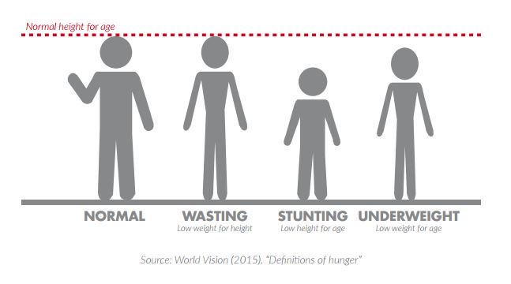

Slide 7
ANALYSIS PROCESS
We used power query to import data from a folder, append the data, and perform various operations such as cleaning, modification, transformation, and manipulation to draw appropriate conclusions. For visualization, we used various charts and value cards to present the key performance indicators (KPI’s).

Slide 8
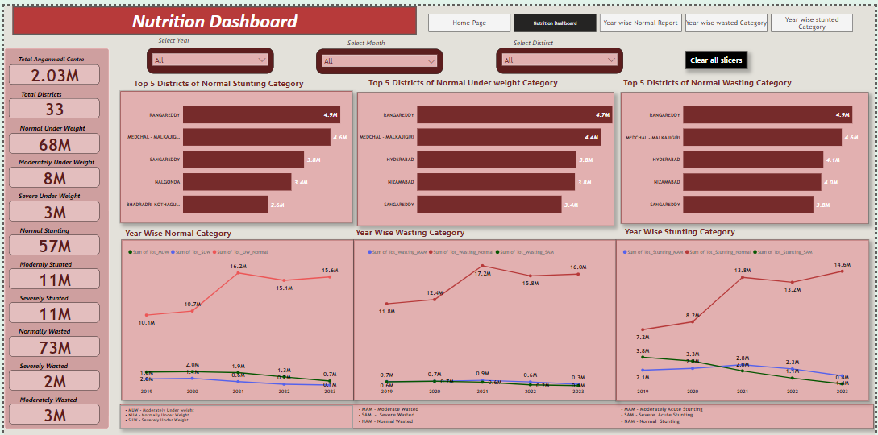
DASHBOARD

Slide 9
2.03 million
Anganiwadi centres
Total 33 Districts
73 million
Wasting Category
68 million
underweight Category
57 million
Stunting Category

Slide 10
Rangareddy district has the highest number of children in normal condition for all three weight categories: 4.9 million for stunting, 4.7 million for underweight, and 4.9 million for wasting.
For the normal weight category, the number of people (in millions) was 10.1 in 2019, 10.7 in 2020, 16.2 in 2021, 15.1 in 2022, and 15.6 in 2023.
For the severe weight category, the number of people (in millions) was 2.0 in 2019, 1.07 in 2020, 0.6 in 2021, 0.2 in 2022, and 0.1 in 2023.
For the moderate weight category, the number of people (in millions) was 1.0 in 2019, 2.0 in 2020, 1.9 in 2021, 1.3 in 2022, and 0.7 in 2023.
For the normal wasted weight category, the number of people (in millions) was 11.8 in 2019, 12.4 in 2020, 17.2 in 2021, 15.8 in 2022, and 16.0 in 2023.
For the severe wasted weight category, the number of people (in millions) was 0.7 in 2019, 0.7 in 2020, 0.9 in 2021, 0.6 in 2022, and 0.3 in 2023.
For the moderate wasted weight category, the number of people (in millions) was 0.6 in 2019, 0.7 in 2020, 0.6 in 2021, 0.2 in 2022, and 0.1 in 2023.

Slide 11
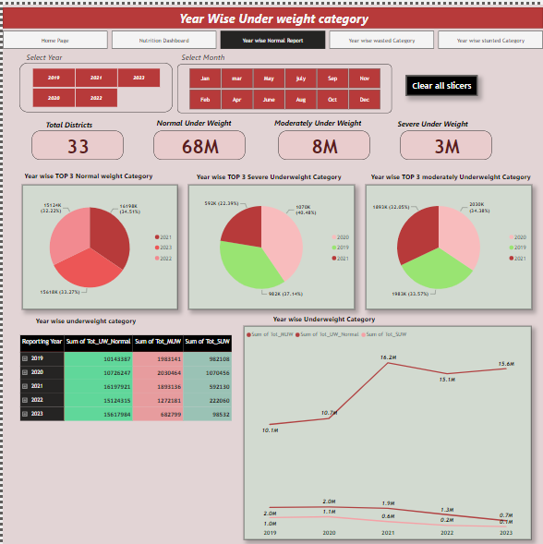
Year wise under weight category

Slide 12
Normal underweight category: In this category are 2021, 2022, and 2023, with 16198K (34.51%), 15124K (32.22%), and 15168K (33.27%) children respectively. This indicates that the number of normal weight children has increased over the years, which is a positive sign for the health and nutrition of the children. Severe underweight category: In this category are 2019, 2020, and 2021, with 982K (37.14%), 2030K (34.38%), and 592K (22.39%) children respectively. This indicates that the number of stunted weight children has decreased over the years, which is also a positive sign for the health and nutrition of the children. Moderate underweight category: In this category are 2019, 2020, and 2021, with 1983K (33.57%), 15124K (32.22%), and 1893K (32.05%) children respectively. This indicates that the number of moderate weight children has remained relatively stable over the years, which suggests that there is still room for improvement in the prevention and treatment of acute malnutrition among children.
Year-wise distribution of stunted categories among children in Telangana State from 2019 to 2023. The stunted categories are normal, severe, and moderate as follows:

Slide 13
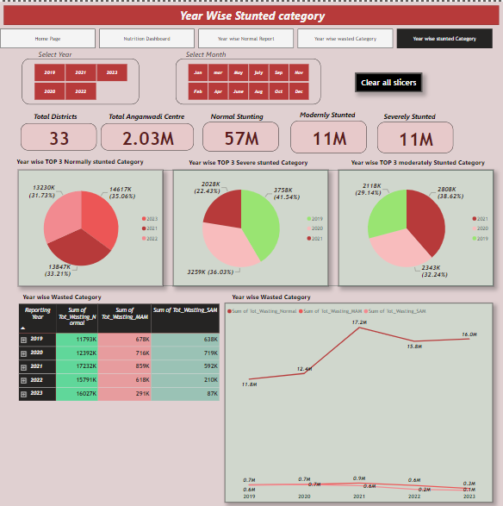
Year wise Stunted Category

Slide 14
Normal stunted category: This category are 2021, 2022, and 2023, with 33.21%, 31.73%, and 35.06% of the total number of children respectively. Severe stunted category: This category are 2019, 2020, and 2021, with 41.54%, 36.03%, and 22.43% of the total number of children respectively. Moderate stunted category: for this category in the year 2019, 2020, and 2021, with 29.14%, 32.24%, and 38.62% of the total number of children respectively.
Year-wise distribution of stunted categories among children in Telangana State from 2019 to 2023. The stunted categories are normal, severe, and moderate as follows:

Slide 15
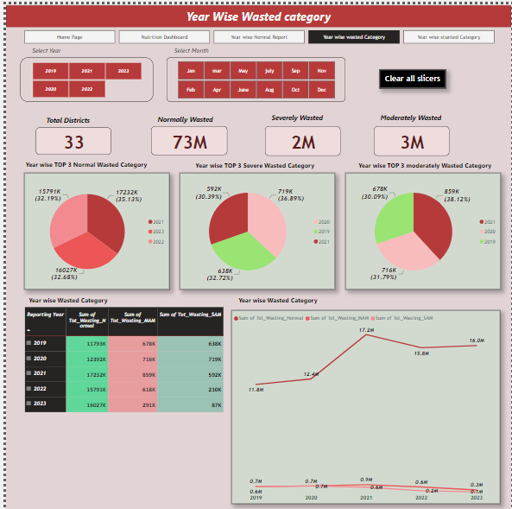
Year wise Wasted category

Slide 16
The normal wasted category has increased over the years, from 35.13% in 2021 to 32.19% in 2022 to, then slightly decreased to 32.68% in 2023. The severe wasted category has decreased over the years, from 32.72% in 2019 to 36.89% in 2020, then slightly increased to 30.03% in 2021. The moderate wasted category has remained relatively stable over the years, ranging from 30.09% to 38.12%. This indicates that there is still room for improvement in the prevention and treatment of acute malnutrition among children, and that the causes and consequences of this condition need to be addressed more effectively.
Year-wise distribution of Wasted categories among children in Telangana State from 2019 to 2023. The stunted categories are normal, severe, and moderate as follows:

Slide 17
CONCLUSIONS
CONCLUSION 1
Normal underweight category
This indicates that the number of normal weight children has increased over the years, which is a positive sign for the health and nutrition of the children.
Severe underweight category
This indicates that the number of stunted weight children has decreased over the years, which is also a positive sign for the health and nutrition of the children.
This indicates that the number of moderate weight children has remained relatively stable over the years, which suggests that there is still room for improvement in the prevention and treatment of acute malnutrition among children.
Moderated underweight category

Slide 18
CONCLUSIONS
CONCLUSION 2
Normal Stunted category
In years of 2021, 2022, and 2023, with 33.21%, 31.73%, and 35.06% of the total number of children respectively. This indicates that the number of normal height children has increased over the years, which is a positive sign for the health and nutrition of the children.
Severe Stunted category
In years for this category are 2019, 2020, and 2021, with 41.54%, 36.03%, and 22.43% of the total number of children respectively. This indicates that the number of severe stunted children has decreased over the years, which is also a positive sign for the health and nutrition of the children.
The top three years for this category are 2019, 2020, and 2021, with 29.14%, 32.24%, and 38.62% of the total number of children respectively. This indicates that the number of moderate stunted children has remained relatively stable over the years, which suggests that there is still room for improvement in the prevention and treatment of acute malnutrition among children.
Moderated Stunted category

Slide 19
CONCLUSIONS
CONCLUSION 3
Normal Wasted category
This indicates that the number of normal weight children has increased over the years, which is a positive sign for the health and nutrition of the children.
Severe Wasted category
This indicates that the number of stunted weight children has decreased over the years, which is also a positive sign for the health and nutrition of the children.
This indicates that the number of moderate weight children has remained relatively stable over the years, which suggests that there is still room for improvement in the prevention and treatment of acute malnutrition among children.
Moderate Wasted category

Slide 20
THANKS!
Do you have any questions?

